Slide 1


Slide 2

Human Relations

Slide 3
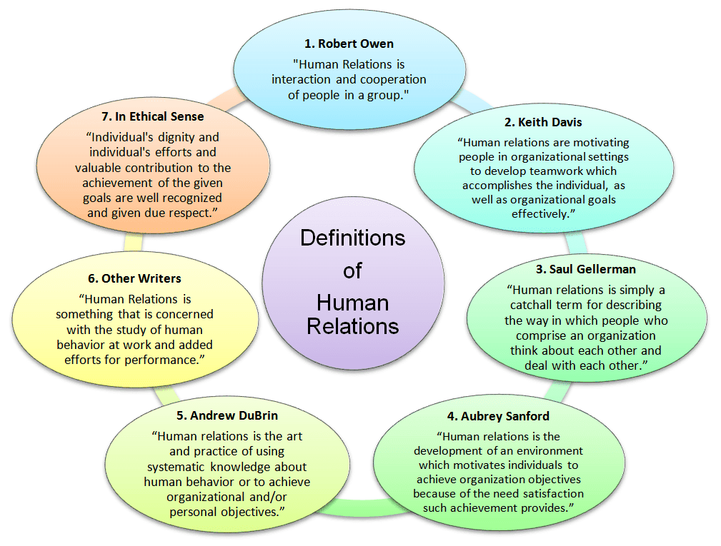
Different perceptions on HR

Slide 4

4 Elements: Effective Communication

Slide 5
HR Skills ?

Slide 6
How you perceive?
Interaction

